Slide 1
FundsBook
Team 16
Luis Diaz, Temuulen Ganbold, Julio Ojalvo

Slide 2
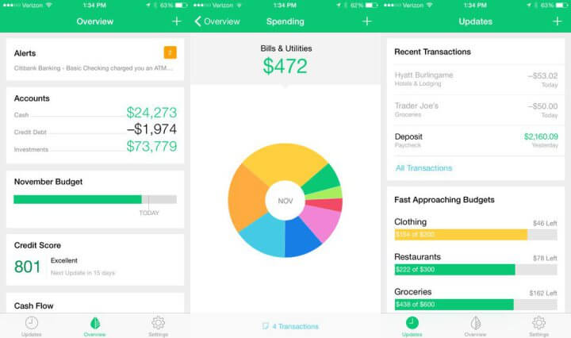
CONCEPT
Social media platform for budgeting and money management
Teach young people what they aren’t taught in high school
Hope to get young people involved in savings
Financial experts can help new users get started

Slide 3
FUNCTIONAL REQUIREMENTS
Profile Creation
Profile Editing
Personal Budgets
Auxiliary Budgets
Followers
Friends
Close Friends
Searching
Achievements
Notifications

Slide 4
CREATING BUDGET PLANS
Personal
User has the ability to create a personal budget for himself/herself to follow
User can deposit different amounts of money into different budget plans
User can add tags, such as the hashtags on social media to identify what kind of budget plan it is
Auxiliary
Secondary budget plans
Personal or public
Different priorities

Slide 5
SOCIAL LIFE
Followers
Option to follow other users on the platform
Can see auxiliary budget plans instantly if profile settings are public
Receive notifications from those who a user follows to see any progress/changes made
Friends
App allows those close to you to become “friends” with you on the app
Friends are allowed to see more detailed information
Allows for “friends” to directly message each other on the app
Close Friends
Allows for advanced features such as sharing budget plans only with close friends
Notifications from close friends only

Slide 6
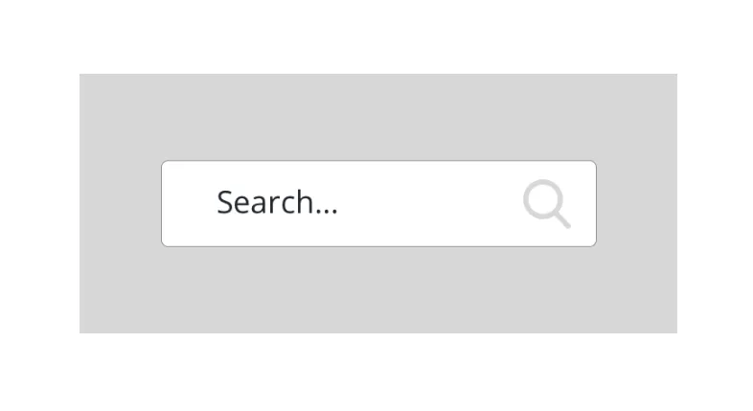
SEARCHING
One of the main tabs is a search bar
Search for specific profiles
Search for certain types of plans based on tags given to them
Hope to personalize usage of the app

Slide 7
ACHIEVEMENT BADGES
Users receive badges to be displayed on their profile for completing certain goals
Hope to encourage users to keep on their path by rewarding them for:
Following a budget for extended periods of time
Creating certain amount of budget plans
Using certain amounts of unique tags on created budget plans

Slide 8
NON-FUNCTIONAL REQUIREMENTS
Information Encryption
Privacy
Bank Account
Balance
Database Management System
Suspicious Activity Detector

Slide 9
INFORMATION ENCRYPTION
All user information will be encrypted to protect against external intruders including:
Username/email
Passwords
Banking information

Slide 10
DATABASE MANAGEMENT
User information will be stored in a database for quick access and protection
Hash tables will be the fastest and safest way to store and retrieve information
Convenient for the user since they can access their accounts quicker

Slide 11
SUSPICIOUS ACTIVITY DETECTION
Detect suspicious activity and alert the user
App alerts user if account is logged into from an unknown location
If user doesn’t respond, account is locked until user can verify identity
Too many failed login attempts will also alert the user

Slide 12
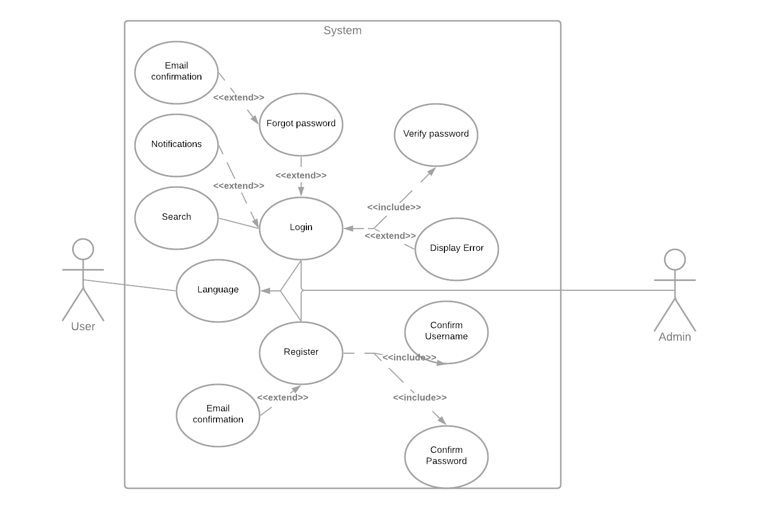
USE CASES AND USE CASE DIAGRAM

Slide 13
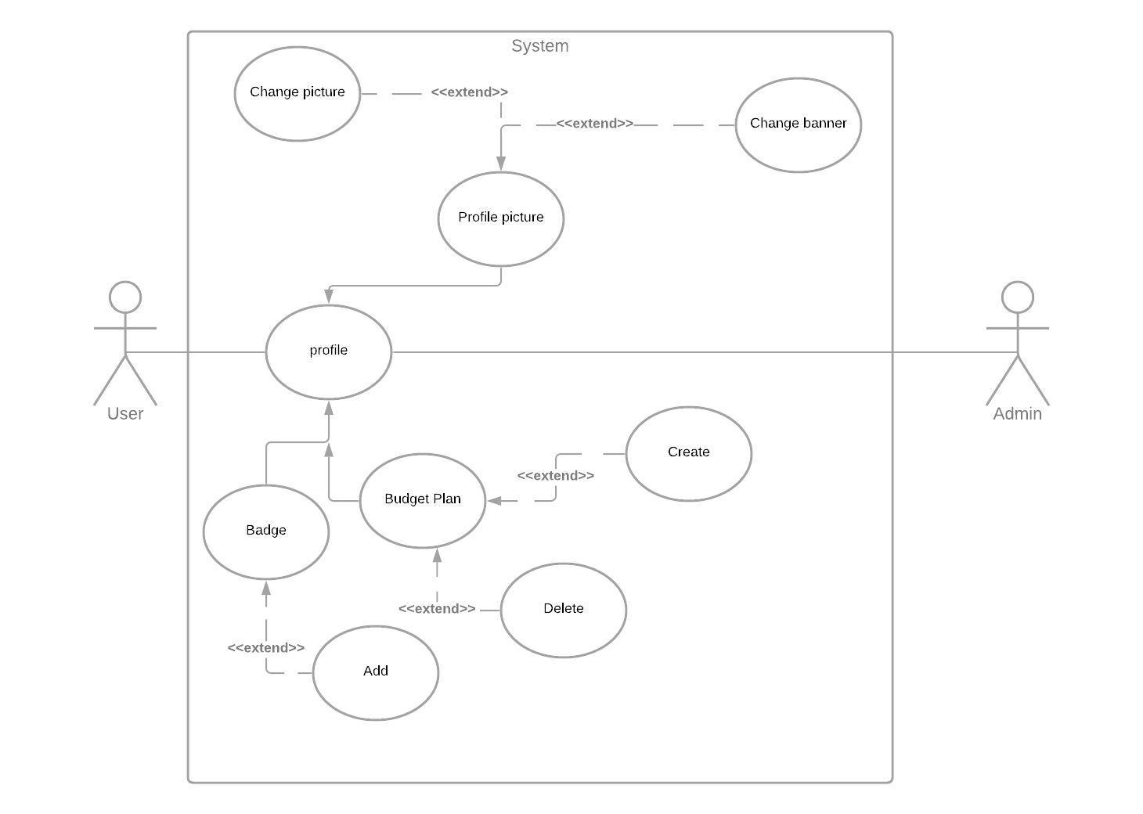
USE CASES AND USE CASE DIAGRAM

Slide 14
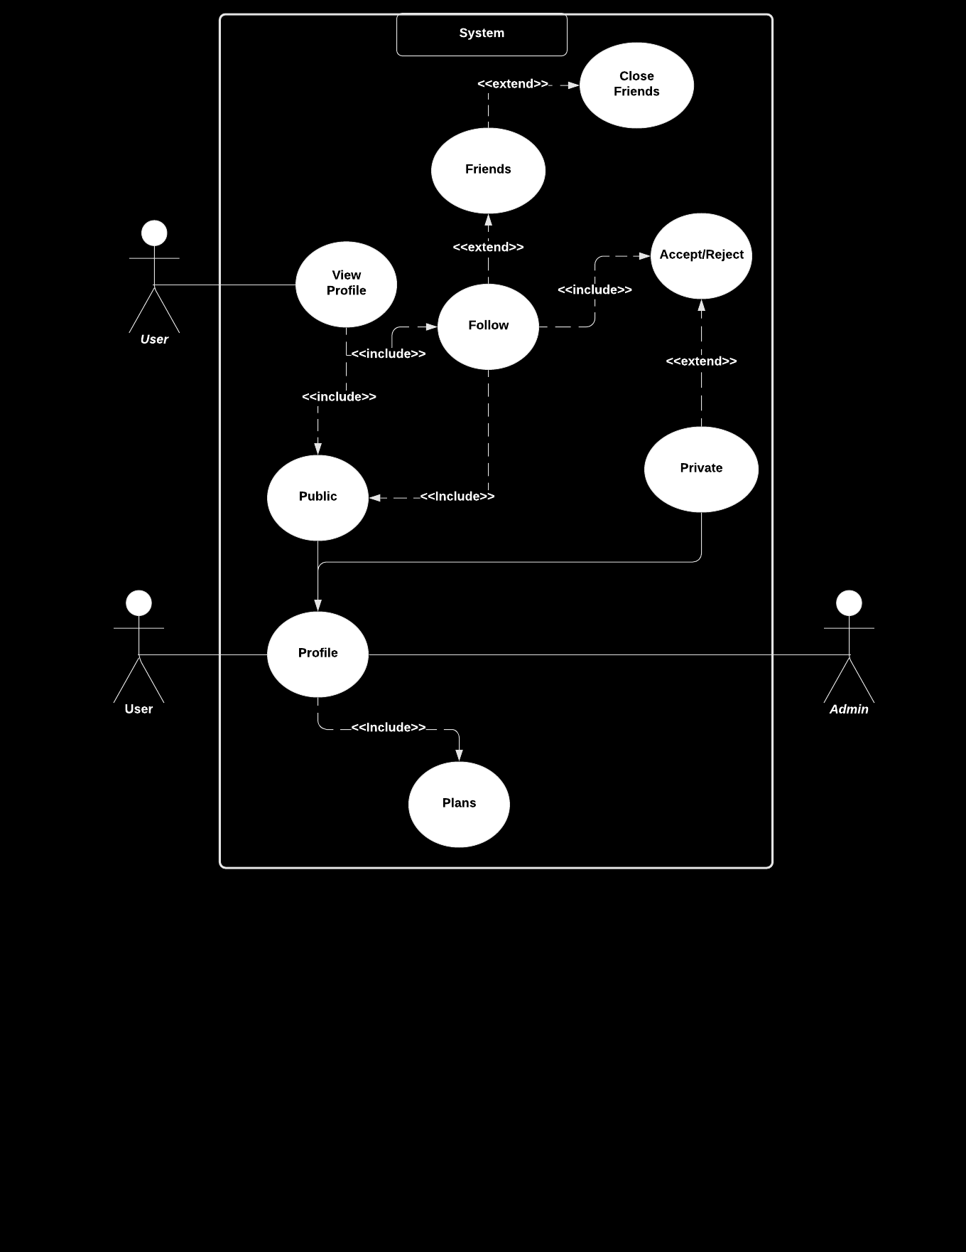

USE CASES AND USE CASE DIAGRAM

Slide 15
SYSTEM CONSTRAINTS
Platform Constraints
App aims to be functional on Apple’s iOS and on the Android operating system only
Language Constraints
Java for Android devices
Swift for iOS devices
Time Constraints
Due to this being a class project, we are restricted with time, until May 1st, to finish this project
Miscellaneous Constraints
Teammates in different time zones causes for a dilemma when it comes to meeting up for ideas

